Slide 1
Illustration
Using examples effectively

Slide 2
Why?
Activity One
Open a word document and label this exercise Activity One
In 3-4 sentences each, answer the following questions:
1. In your daily experience when do you use examples?
2. What kinds of school assignments ask you to use examples?
3. How are the two words example and illustrate related?

Slide 3
Why? Continued
When surveying teachers of other disciplines at LSCO, one writing issue that is repeatedly mentioned is that students struggle with using examples in writing. We feel this is important because examples are used in all types of writing assignments.
Examples support generalizations – a broad statement about a topic
Examples explain or clarify unfamiliar topics, difficult concepts, or abstract terms
Examples add detail and personalization to topics and help a writer connect to their audience
Examples (noticing specific examples) are the start of analysis

Slide 4
What?
It’s important to choose our illustrations (examples) carefully. Many logical fallacies (or errors in thinking) are cased by choosing the wrong examples.
So what should we consider when choosing our examples?
RELEVANCE – This seems obvious, but how many times have you listened to a story that didn’t really relate to the point someone was trying to make or was a stretch at best?
ACCURACY – Again, this might seem obvious, but did it really happen that way?
REPRESENTATIVE – Does this illustration show what “usually” happens or is it a special circumstance, an accident, a coincidence, or unlikely
SPECIFICITY – Does this illustration give enough details to engage the reader and serve the purpose? Is the example so vague that it doesn’t add to the depth of the paper?

Slide 5
HOW?
I have found that the most effective illustrations usually contain the following elements:
P oint - a clear statement of what the writer is trying to get across
I lustration – the example or examples
E xplanation - this is usually the “meat” of the paragraph. It helps connect the point to the example and tells us why it matters. In a larger work the explanation also connects the point to the rest of the points in the work.

Slide 6
an example of PIE in a paragraph
  There are times when doing something badly is significantly better than doing nothing at all (1). Our local newspaper featured a story about a hiker who was miles from anywhere on the trail when he came across another hiker who was choking on his lunch (2). He knew he couldn’t run for help and he was out of cell phone range (3). He also knew that the man in front of him was starting to turn blue (4). He pounded the man on the back, but that didn’t work (5). Finally, in desperation he pushed down underneath the man’s rib cage (6). The pressure popped something out of his windpipe, and he started breathing again (7). Because the hiker didn’t know CPR, the Heimlich maneuver, or other lifesaving skills he could have done tremendous damage, perhaps breaking the victim’s ribs (8). Clearly, it would be worthwhile to have lifesaving skills, but if the hiker had just stood there paralyzed by his lack of expertise, the man would have choked to death (9). Fortunately, he seems to have believed in my slogan and did what was worth doing, saving a life, even if he did it badly (10).

Slide 7
Example Continued
ACTIVITY TWO
In the same word document identify this as Activity Two and then using the numbers by each sentence identify the P, the I, and the E of the previous paragraph.

Slide 8
Example Answers
There are times when doing something badly is significantly better than doing nothing at all (1). Our local newspaper featured a story about a hiker who was miles from anywhere on the trail when he came across another hiker who was choking on his lunch (2). He knew he couldn’t run for help and he was out of cell phone range (3). He also knew that the man in front of him was starting to turn blue (4). He pounded the man on the back, but that didn’t work (5). Finally, in desperation he pushed down underneath the man’s rib cage (6). The pressure popped something out of his windpipe and he started breathing again (7). Because the hiker didn’t know CPR, the Heimlich maneuver, or other lifesaving skills he could have done tremendous damage, perhaps breaking the victim’s ribs (8). Clearly, it would be worthwhile to have lifesaving skills, but if the hiker had just stood there paralyzed by his lack of expertise, the man would have choked to death (9). Fortunately, he seems to have believed in my slogan and did what was worth doing, saving a life, even if he did it badly (10).

Slide 9
Example Continued
Red – This is the point of the paragraph
Blue – This is the illustration – the example – what happened
Yellow – This is the explanation. This is the analysis or how the example connects to the point.

Slide 10
Why is each part important?
Activity Three – In the same word document label this activity and then write 2-3 sentences about why you think each of these parts of the paragraph are important.
P
I
E

Slide 11
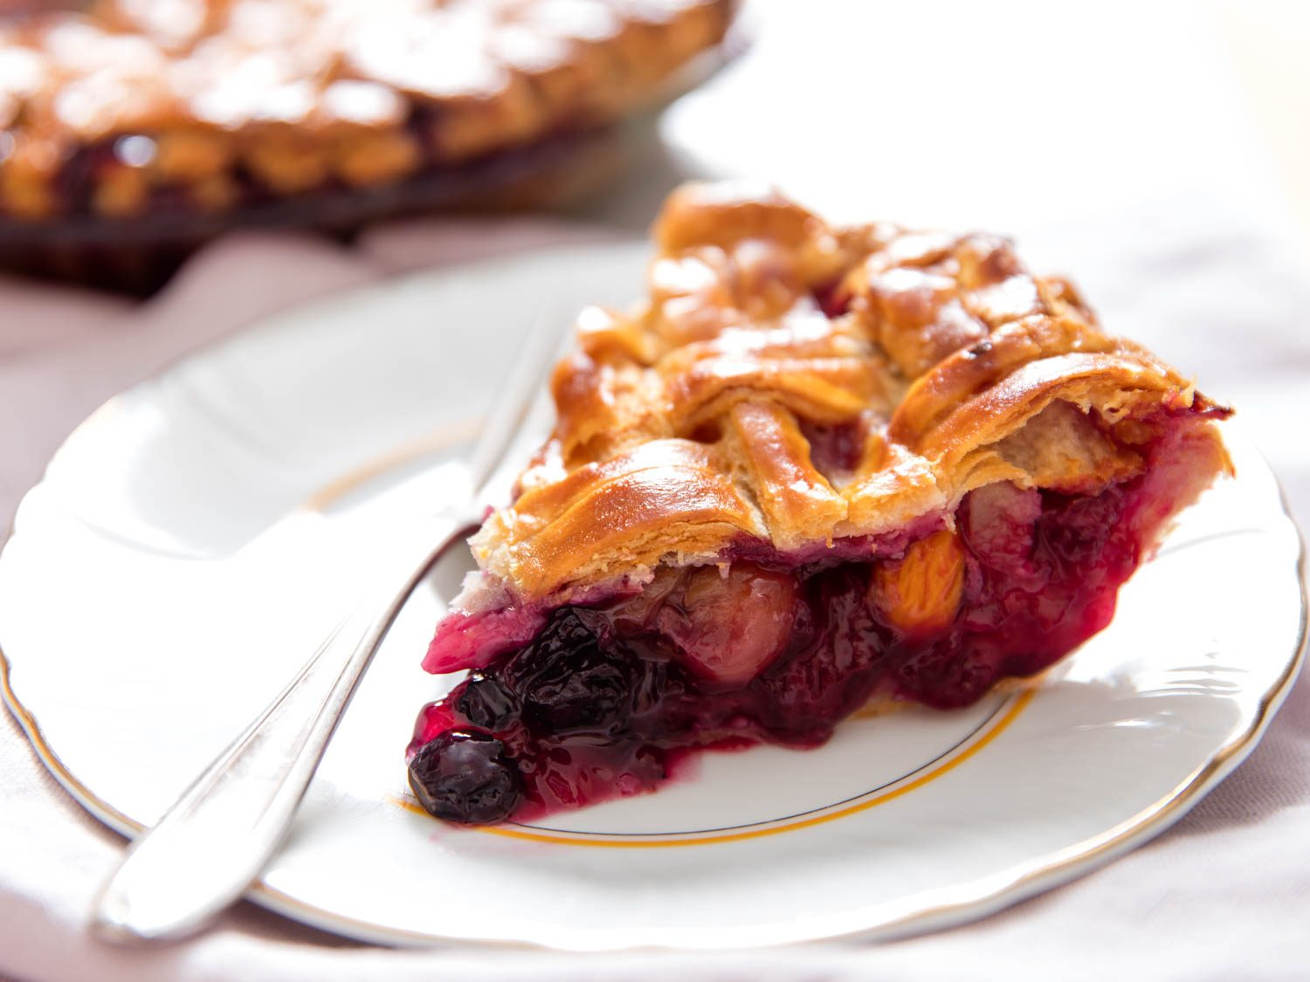
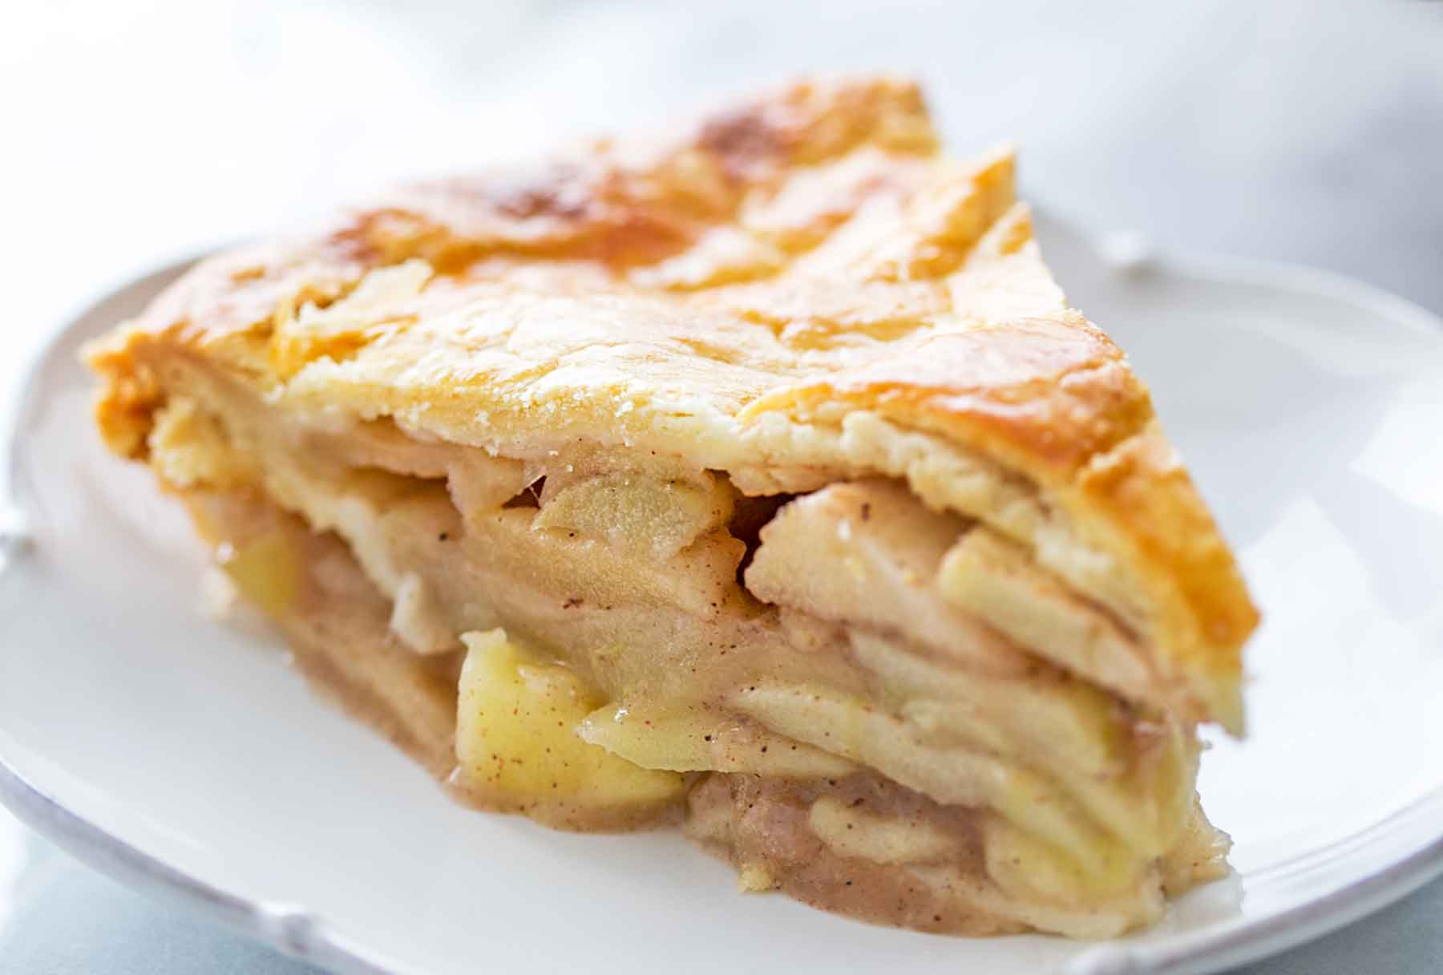
Choose Wisely
Remember that you should only have one point per paragraph. Everything (the I and the E) should work to expand, clarify, explain one point. We don’t like mixed berry pies. When we change points (berries) we change paragraphs (pies).

Slide 12
Do We Really Use this?
The following slides are examples of how we might use the PIE principles in school, at work, and in our personal lives.

Slide 13
School Prompts
Explain Social Construction Theory through your observations.
Describe the mood of the country during the Vietnam War using specific examples from history.
Use specific examples to describe the lifestyle changes someone who was recently diagnosed with diabetes should make.
What does Kate Chopin’s “The Story of an Hour” say about relationships? Justify your answer using specific examples.

Slide 14
Work Prompt
Use a specific example to explain what you have learned from your mistakes?
Use specific examples to explain how you like to lead or be led?
Use specific examples to explain how your strengths would benefit our team?

Slide 15
Personal Prompts
When was the last time you felt real excitement and passion in your life? How important is passion to you?
What kinds of movies do you like and why?
How do you think your use of technology affects you?
If you could gain one ability or quality you admire in someone else, what would you choose? Why do you think this quality has enhanced their life or could enhance yours?

Slide 16
Activity FOUR
You don’t have to use any of the prompts on the previous slides, but you may if you would like.
Write one paragraph for each category (School, Work, Personal) using the principles of PIE.
The paragraphs will be worth 25 points each and be graded on depth, organization, and by evaluating each part of the P.I.E.
You may do this activity in the same Word document at the previous activities.

